Slide 1
Sales Data Analysis for ABC India Pvt. Ltd.
Insights and Recommendations

Slide 2
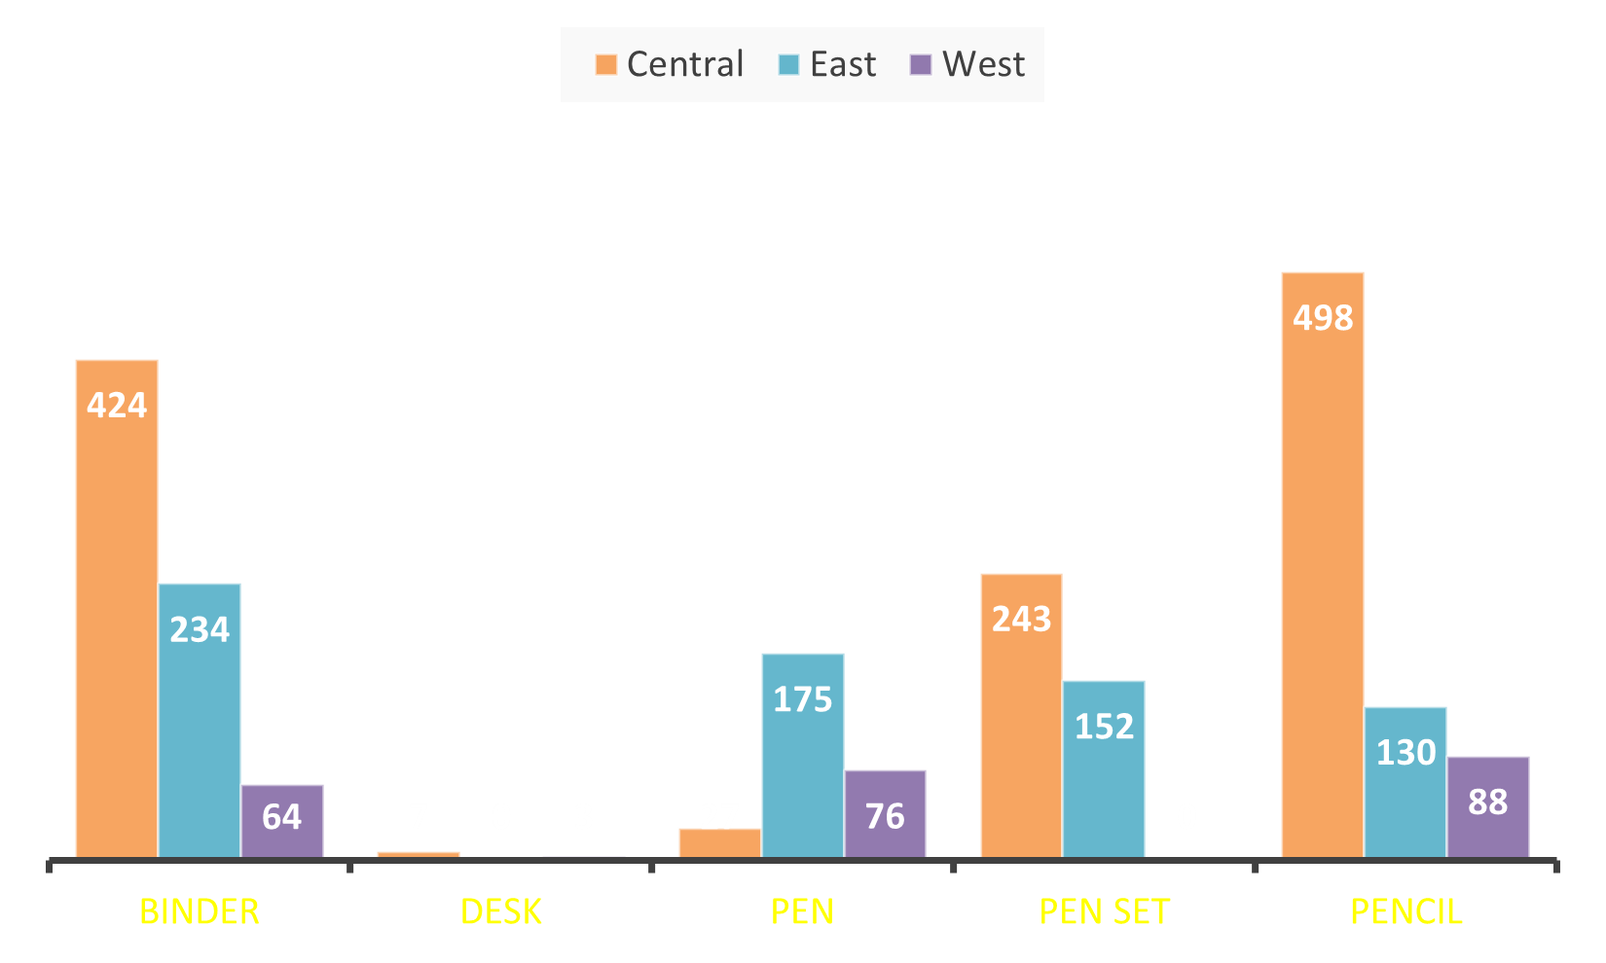
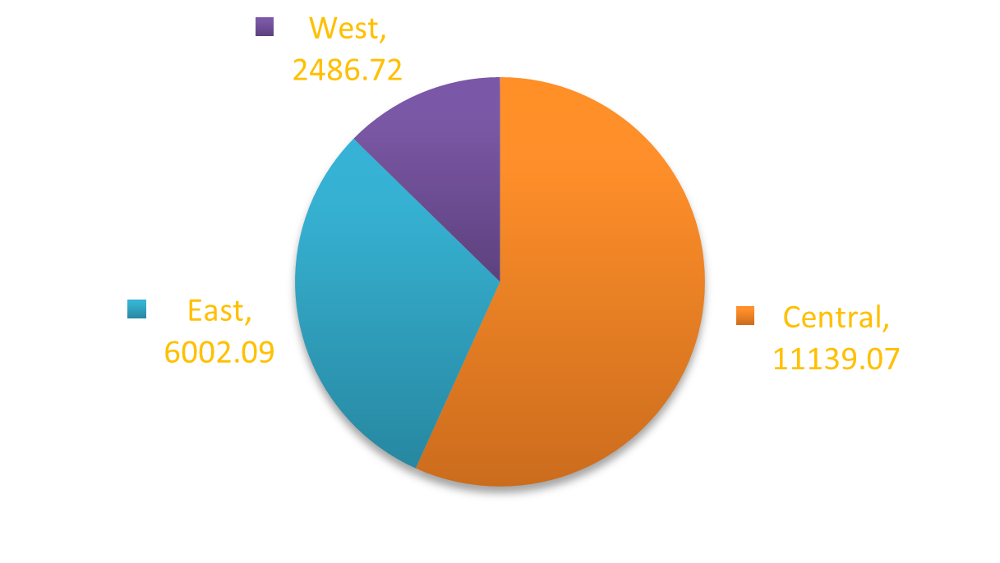
The Central region has the highest number of transactions, indicating a significant market presence. The East region shows a considerable volume in specific high-value items like pen sets and binders. The West region has fewer transaction but some high value items
Sales by Region

Slide 3
Top-Selling Items
Pencils and binders are the most frequently sold items, particularly in the Central and East regions. Pen sets have significant sales in both the Central and East regions, indicating strong demand for these items.

Slide 4
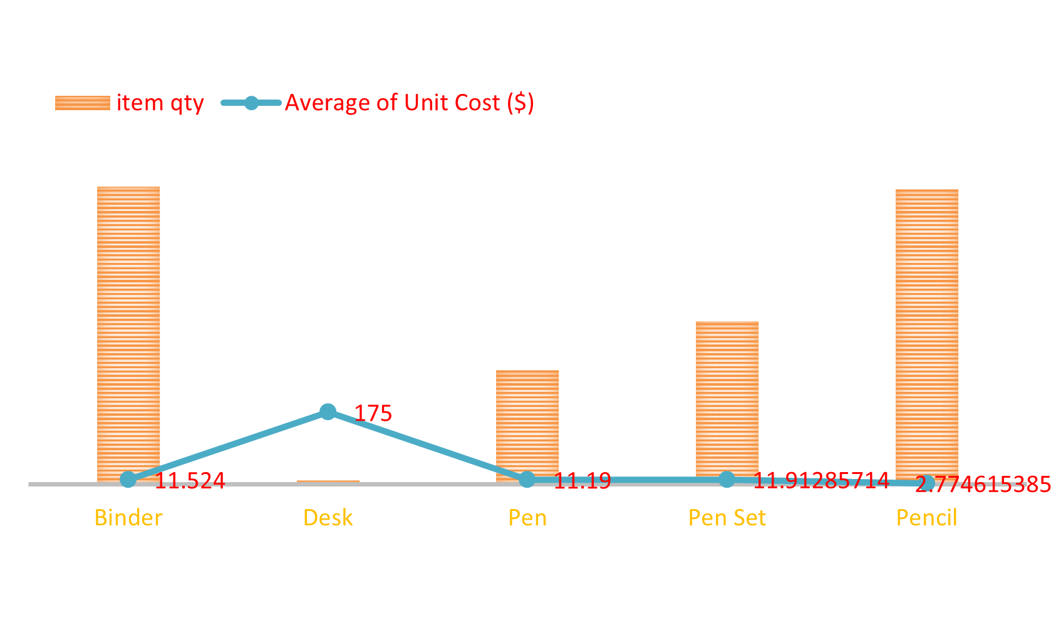
Price and Volume Analysis
Items like desks and pens have fewer units sold but contribute significantly to revenue due to their high unit cost. Lower-cost items like pencils are sold in large quantities, indicating they are a staple product.

Slide 5
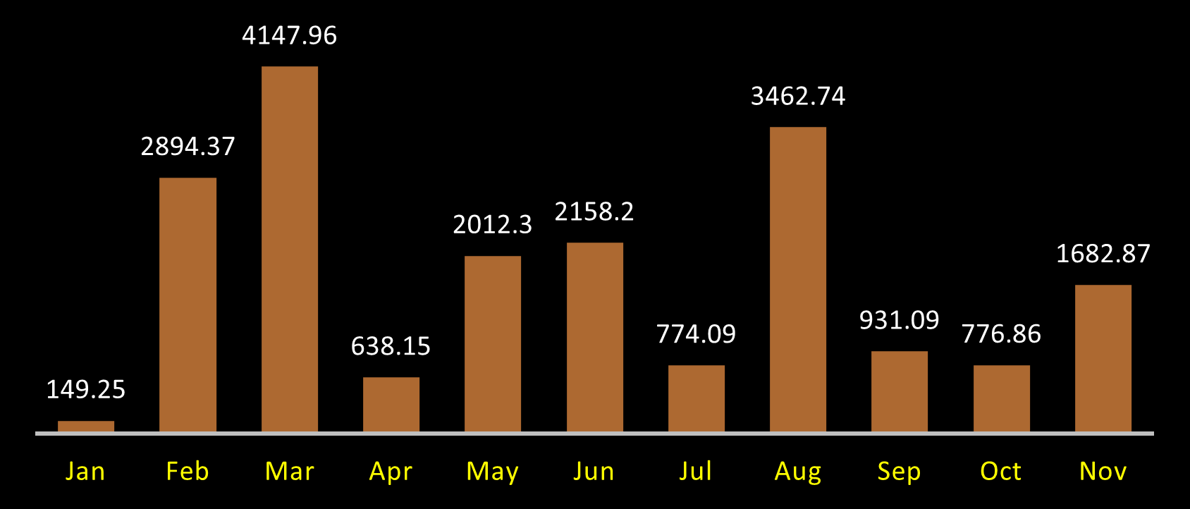
Monthly Trends
There are consistent sales across all months, but certain months (e.g., March and May) show a spike in transactions, which may correlate with specific events or demand cycles.

Slide 6


Thank You So Much
Mo Asif
https://www.linkedin.com/in/mo-asif39/
https://github.com/asifaslam39

